Slide 1

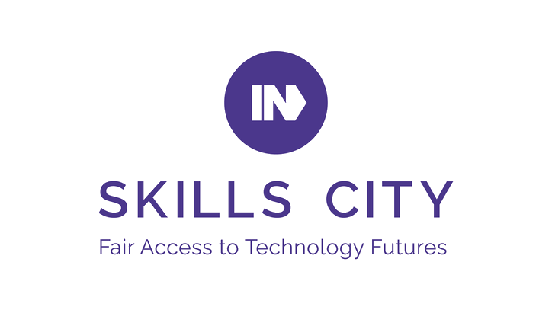
MeterReader+
NSG Europe
Group Members: Stephen Fernley, Dominic Cheung, Dandi Kridi, James Grainger.
Client Delegates: Arul Viswanathan, Stephen Baribal, Peter Lai.
Date of Presentation: 16th January 2025

Slide 2
Introduction
Project Brief: Create an intuitive (full-stack) web application prototype called MeterReader+ to enable engineers to capture meter readings in real-time.
Key Functionalities:
Solutions: Two different solutions which both utilise server-less architecture. Both are low cost, straightforward applications which can capture front end meter readings and store in a database.

Slide 3

Stephen Fernley
University Education
BA (Hons.) International Relations and Modern History, Swansea University
Foundation Year, BSc (Hons) Geography, University of Salford
Professional Background
Customer service focused with interests in project management, events, administration and sustainability.
Research Interests- Database management, infrastructure as code, server-less architecture and JavaScript.
Role in the project
Project Manager

Slide 4

Dominic YT Cheung
City University of Hong Kong
Bsc (Hons) in Computer Study
Msc in Automation Systems and Management
+5 years' experience in private cloud and Over-The-Top cloud services
Teesside University in North East England
Certificate in AI from coding to machine learning
1 year experience in Inter-Course-Assessment project – Using AI to improve the UK road safety (up to 96% accuracy score by regression classification)
Research Interests
AWS cloud foundation
Amplify Gen2 Full Stack Web Development (Launch on 6 May 2024)
Role in the project
Solution Architect

Slide 5

Dandi Kridi
Role in Project:
AWS Cloud Solutions Architect
University degrees:
B.Tech Petrochemical Engineering (Rivers State University, Port Harcourt, Nigeria).
MSc Environmental Engineering (University of Strathclyde, Glasgow, Scotland).
MSc Petroleum and Gas Engineering (University of Salford, Manchester, UK)
Technical Background:
Engineering minded Business Data analyst focused on solving business problems with AWS cloud services.
Research Interests:
Customized Cloud Services and Solutions
Data Analytics
Cloud and Network Security
Full-Stack Development

Slide 6

James Grainger
Role in Project
Cloud Engineer
Professional Background
Chef working in fast paced environment working to meet exacting specifications and ensure customer satisfaction.
Research Interests
Cloud engineering, front-end development, HTML, CSS, web design.

Slide 7

Lambda Solution

Slide 8
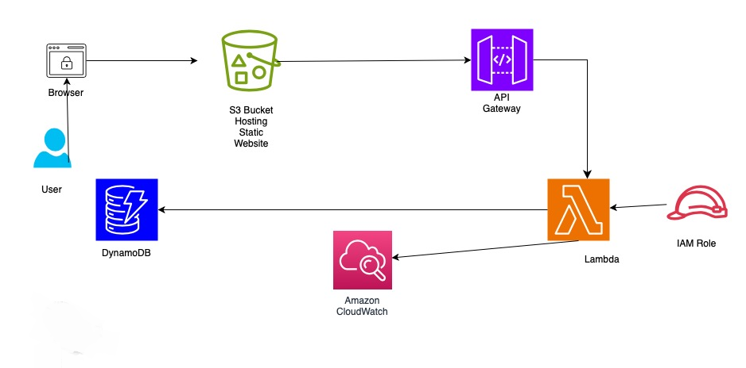
Architecture Diagram

Slide 9
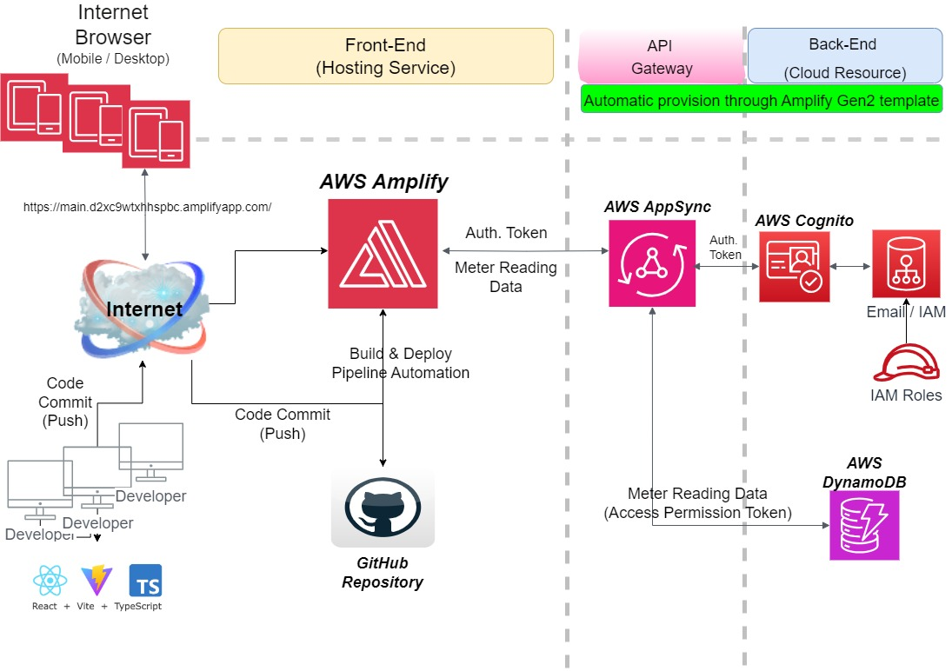
Solution Architecture

Slide 10
Methodology
DevOp and CICD pipeline automation method
Git / Github
AWS Amplify and Github integration
Sandbox
Release management
Automation of build and deploy
Event-Driven Stateful Application
User sessions are maintained (e.g., using cookies, tokens, or server-side storage)
Live Data session approach

Slide 11
Why Amplify Architecture ?
Scalability by Default with serverless infrastructure and global reach.
Rapid Development using Amplify CLI, codegen, and modern frameworks.
Real-Time and Offline Capabilities powered by AppSync and DataStore.
Built-In Security with Cognito and fine-grained access control.
Cost-Effectiveness with pay-as-you-go pricing and serverless efficiency.
Notes:
Scalability by Default
Serverless Backend: Amplify Gen 2 automatically provisions and manages serverless resources like DynamoDB, AppSync, Lambda, and S3. This ensures that your application scales effortlessly to handle large numbers of users without manual intervention.
Global Reach: By integrating with AWS services, Amplify provides global scalability with low latency using AWS's Content Delivery Network (CDN) and edge services like CloudFront.
2. Rapid Development with Flexible Customization
Codegen and CLI Tools: Amplify Gen 2 makes it easy to set up a full-stack application in minutes, with CLI tools that automate infrastructure setup for GraphQL APIs, storage, and authentication.
Customization-Friendly: Unlike Gen 1, Gen 2 allows for more flexibility. Developers can tailor backend resources without being constrained by the Amplify-provided configurations, enabling greater control over infrastructure.
Supports Modern Frameworks: Gen 2 works seamlessly with popular frontend frameworks like React, Next.js, and Vue.js, enhancing developer productivity.
3. Real-Time and Offline Capabilities
Real-Time Data with AppSync: Amplify Gen 2 leverages AppSync to support real-time updates and subscriptions, making it ideal for chat apps, live dashboards, and collaborative tools.
Offline-First Features: With Amplify DataStore, your application can function offline, automatically syncing data to the backend when reconnected, ensuring a seamless user experience.
4. Security and Authentication Built-In
AWS Cognito Integration: Amplify Gen 2 natively integrates with AWS Cognito to provide robust user authentication, authorization, and user pool management.
Role-Based Access Control (RBAC): Offers fine-grained control over API and data access through AppSync resolvers, making it easy to implement secure multi-tenant or role-based applications.
Encryption and Compliance: AWS handles encryption (data at rest and in transit) and complies with industry standards (e.g., GDPR, HIPAA).
5. Cost-Effective with Pay-As-You-Go
Serverless Cost Model: You only pay for what you use, avoiding the upfront costs of managing servers or unused capacity.
Efficient Resource Utilization: Services like DynamoDB's on-demand mode and Lambda’s event-driven compute ensure that your resources scale based on real-time demand, keeping costs optimized.
Predictable Pricing for Small Applications: Amplify offers free-tier benefits and low costs for smaller-scale apps, making it accessible for startups and prototypes.

Slide 12
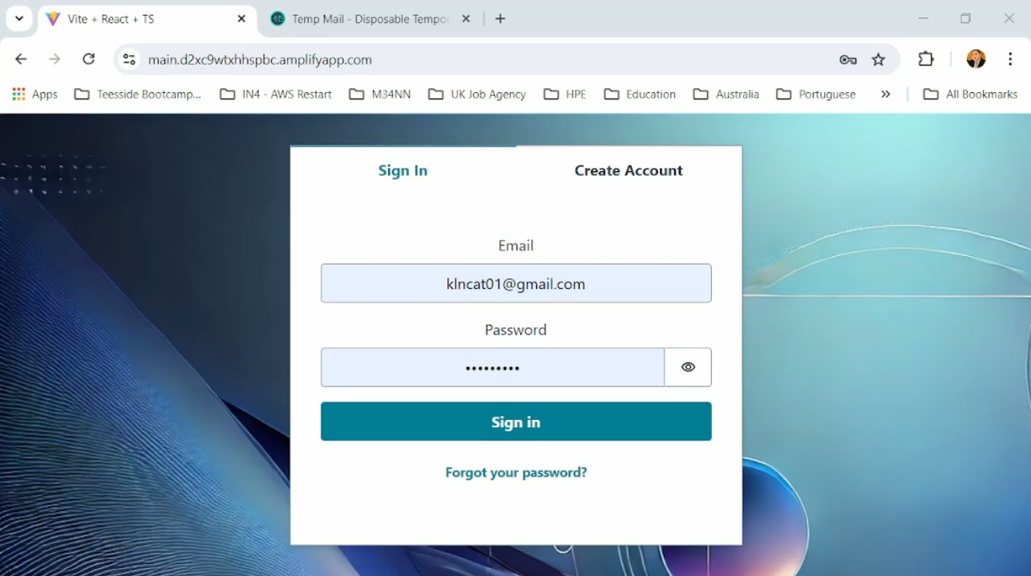
Demonstration – Create User

Slide 13

Demonstration – Meter Reading

Slide 14
Conclusions
AWS Solutions for Meter Reading Applications
Architectures
S3 Static Web Application: Simplified hosting for static content.
Amplify Stateful Application: Ideal for dynamic, interactive use cases.
Key Benefits
Rapid Development: AI coding and DevOps automation reduced time-to-market and supported agile team collaboration.
End-to-End Security: AWS provides HTTPS, Cognito authentication, and data session integrity for robust data protection.
Big Data Ready: DynamoDB's unstructured format enables seamless scaling and easy addition of new data attributes.
Operational Excellence
Error Reduction: QR code integration ensures accurate meter readings directly updated into the database.
Cost Efficiency: Serverless architecture eliminates upfront costs, with minimal, usage-based charges for hosting (S3 or Amplify).

Slide 15
Evaluation
Evaluation What went well? Connecting the front end and back end went pretty smoothly with only a few minor hiccups.
What would you do differently next time? From having a more understanding of what works software works well together and easy of use I would have a clearer plan of what to get started on sooner, giving me more time to develop and improve the user experience and security of the overall project.
What would you change? Implement a more secure system, including cognito as an easy way to create and manage users.
What did you enjoy the most? Debugging, testing front-end code and making a user interface that works smoothly.

Slide 16
Thank you for listening! Any questions?
0161 686 5770
info@in4group.co.uk
Twitter @IN4Group
www.in4group.co.uk

